Slide 1


Common Cyber Attacks and countermeasures
Cyberattacks pose a significant threat to individuals and organizations. Understanding common attack methods and defense strategies is crucial for protecting sensitive data and maintaining online security.

Slide 2

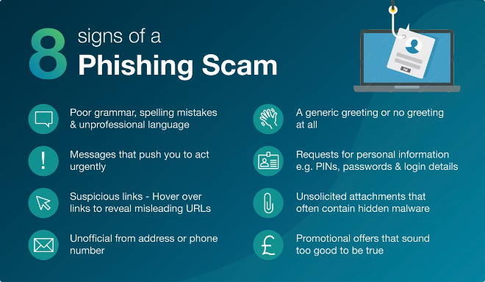
Phishing Attacks: Techniques and Countermeasures
1
Email Spoofing
2
URL Manipulation
Attackers impersonate legitimate entities, such as banks or social media platforms, to trick victims into revealing sensitive information.
Phishing emails often contain links that redirect users to malicious websites designed to steal login credentials or other personal data.
3
Social Engineering
4
Countermeasures
Attackers employ psychological tactics to exploit human vulnerabilities, such as curiosity, trust, or fear, to induce victims into clicking malicious links or downloading malware.
Be cautious of suspicious emails, verify the sender's identity, avoid clicking on links from unknown sources, and use strong passwords and multi-factor authentication.

Slide 3
ARP Poisoning: Exploits and Mitigation Strategies
ARP Poisoning
Mitigation Strategies
Attackers send forged Address Resolution Protocol (ARP) messages to associate their own MAC address with a legitimate IP address on the network.
Use static ARP entries to bind specific MAC addresses to IP addresses, preventing attackers from forging ARP messages.
Enable ARP inspection on network devices to detect and block forged ARP packets.
This allows them to intercept network traffic intended for other devices, potentially stealing sensitive data or launching further attacks.
Use secure network protocols, such as HTTPS, to encrypt data transmitted over the network, making it more difficult for attackers to intercept and exploit.

Slide 4


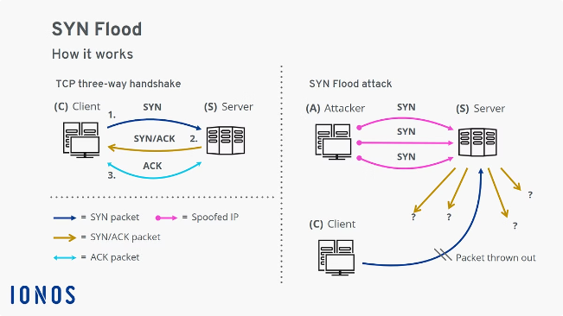


MAC Flooding: Attacks and Protective Measures
Attacker Sends Frames
The attacker sends a large number of frames with unique MAC addresses, flooding the switch's MAC address table.
Switch Overwhelmed
The switch's MAC address table becomes saturated and unable to process new entries, leading to a denial-of-service attack.
Network Disrupted
The switch cannot properly route traffic, causing network performance to degrade and potentially preventing legitimate users from accessing resources.

Slide 5

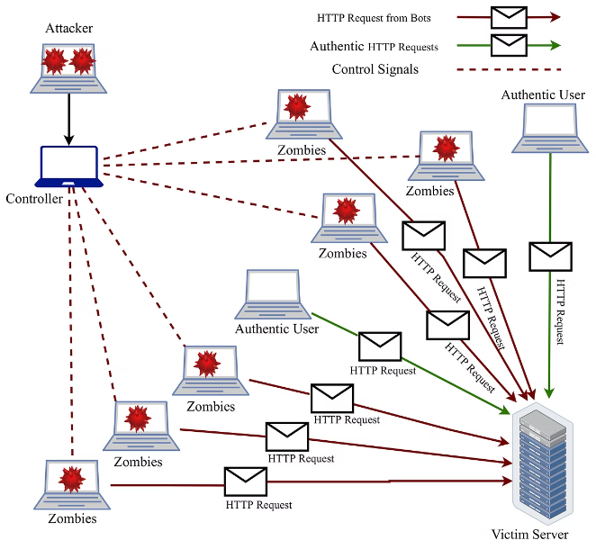
Denial of Service (DoS) Attacks: Types and Defenses
SYN Flood
Ping of Death
Attackers send a large number of SYN packets, overwhelming the target server's resources and preventing legitimate connections from being established.
Attackers send oversized ICMP packets, causing the target system to crash or freeze, effectively denying service to legitimate users.
Smurf Attack
Defenses
Attackers send ICMP echo requests to a network broadcast address, flooding the target system with responses, causing it to become overloaded.
Use firewalls to block known attack traffic, implement rate limiting to prevent excessive traffic from reaching the server, and employ intrusion detection systems to identify and block malicious activity.

Slide 6

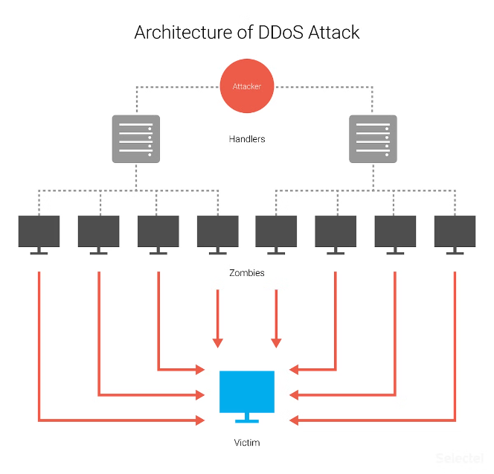
Distributed Denial of Service (DDoS) Attacks: Strategies and Countermeasures
1
Botnet Creation
Attackers compromise a large number of computers, known as bots, and create a botnet, which they can control remotely.
2
Attack Launch
The attacker sends commands to the botnet, directing it to launch a coordinated attack against the target server, overwhelming it with traffic.
3
Target Overwhelmed
The target server becomes unable to handle the massive volume of traffic, resulting in a denial of service for legitimate users.

Slide 7

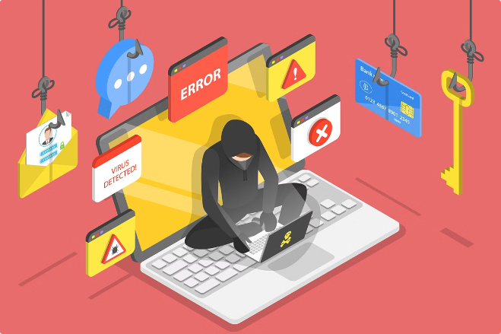
Social Engineering Tactics in Cyber Attacks
Baiting
Offering enticing rewards or incentives to trick victims into clicking malicious links or downloading malware.
Pretexting
Creating a believable story or scenario to gain access to sensitive information.
Scare Tactics
Using fear or urgency to manipulate victims into revealing personal information or making rash decisions.
Impersonation
Pretending to be someone trustworthy, such as a colleague, IT support, or a government official, to gain access to confidential data.

Slide 8

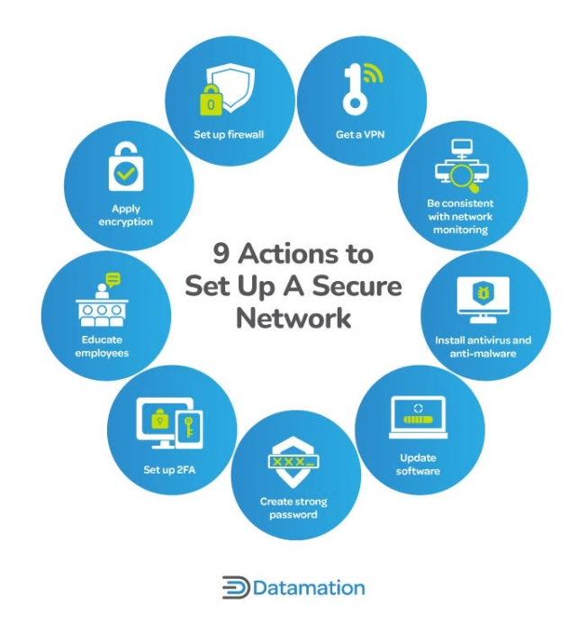
Best Practices for Network Security and Monitoring
1
Firewall
2
Intrusion Detection System (IDS)
Implement a firewall to block unauthorized access to the network and filter incoming and outgoing traffic.
Deploy an IDS to monitor network traffic for suspicious activity and alert administrators to potential threats.
3
Regular Security Audits
4
Security Patching
Conduct regular security audits to identify vulnerabilities and ensure security measures are effective.
Patch software and operating systems promptly to address security vulnerabilities and prevent attackers from exploiting known weaknesses.

Slide 9

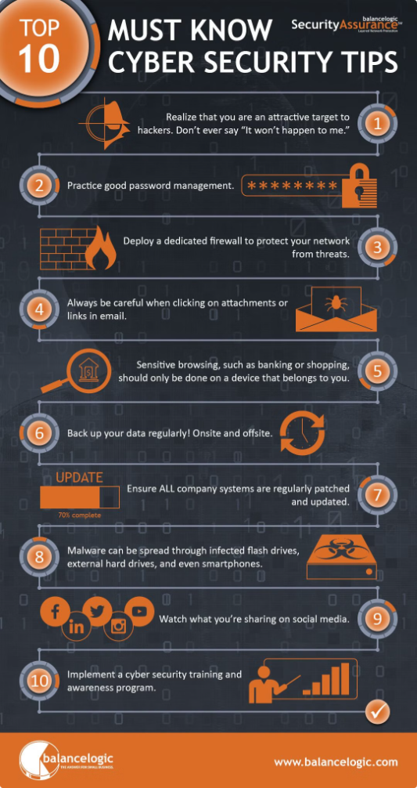
Proactive Approach to Cyber Attack Prevention
Proactive cybersecurity measures are essential for mitigating the risks of cyber attacks. Organizations and individuals must stay vigilant, adopt best practices, and stay informed about emerging threats to stay ahead of attackers.

